Slide 1
Webpack(v2) 101
Magnum Noree

Slide 2
Requirements
Git
Node v 6.9+
Npm version 3+

Slide 3
Requirements
Git
Node v 6.9+
Npm version 3+

Slide 4
Why does webpack exist?
Helps with projects that requires tons and tons of scripts that need to be loaded in order.
IE: If a script depends on another script, you need to make sure it loads after the other.
WHAT A NIGHTMARE

Slide 5
Webpack vs Grunt / Gulp
What are some of the things you do with Grunt or Gulp?
Concatenate Javascript / CSS / Fonts / Images / SVG
Minify
Other various things to optimize assets for your application
With Webpack, you no longer need Task Runners
Webpack turns everything into a module; Conceptually, JS is a module
Webpack also considers CSS to be a module
Also allows you to use AMD, CommonJS, or ES6 imports to make your dependencies explicit.

Slide 6
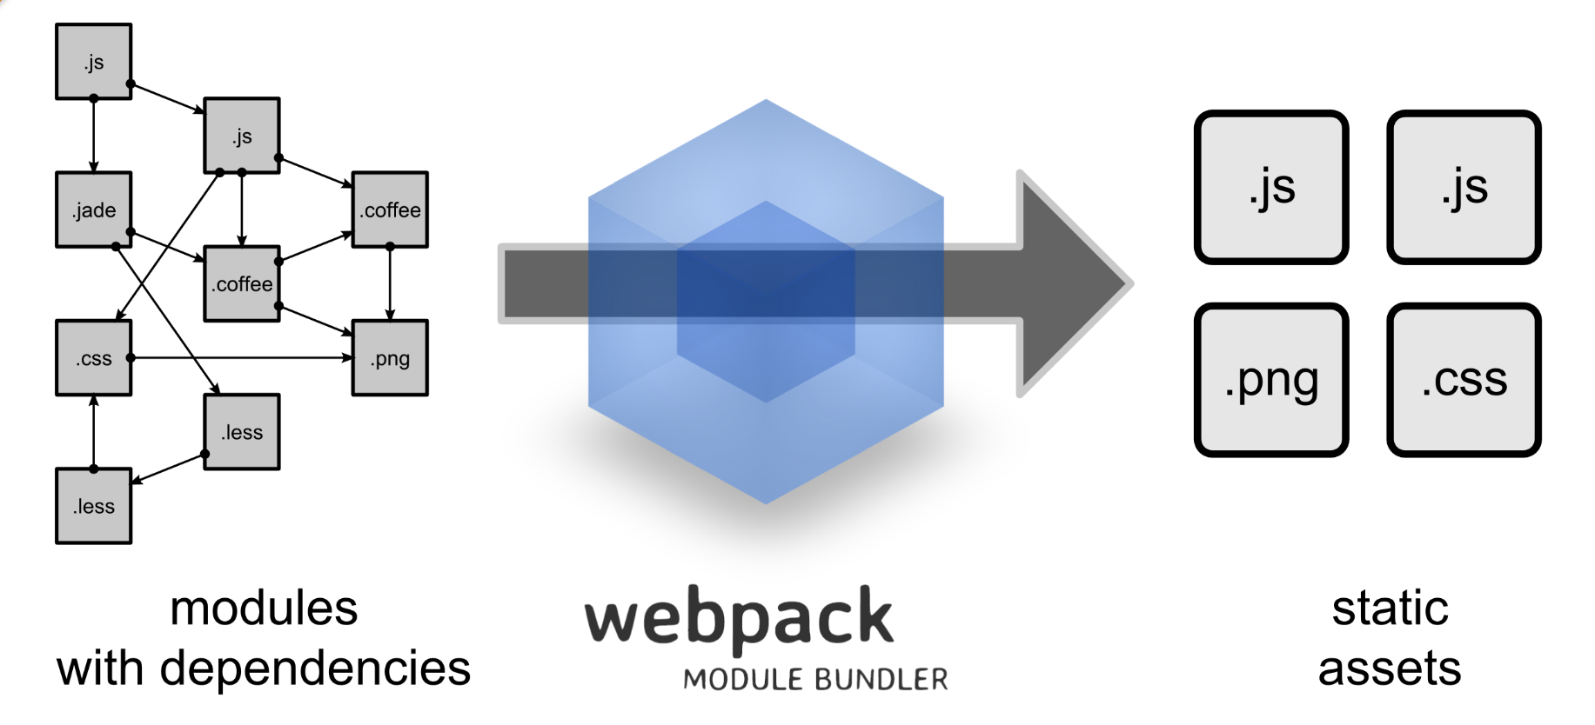

Slide 7
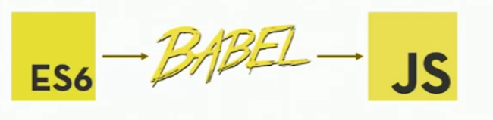
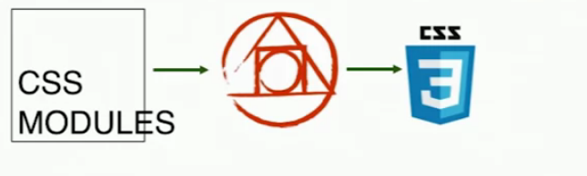
Loaders
Per-file processing

Slide 8
Plugins
Plugins handle everything else:
Has access to webpack’s compilation processes and thus, can intercept webpack’s execution through hooks.
Existing (and popular) plugins:
Service Workers
Lodash
Gzip
ExtractTextWEbPlugin
AND HUNDREDS MORE…!!!

Slide 9
LETS GET TO IT
Git clone https://github.com/Magneticmagnum/webpackworkshop.git

Slide 10
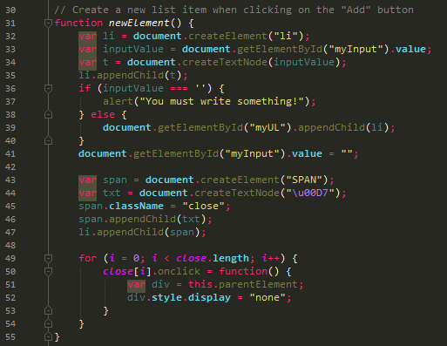
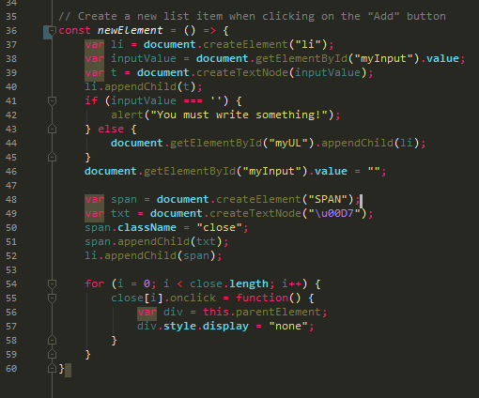
Transpiling with Babel
Lets say we want to introduce some es6 in our JS file because we want tobe up to date with the latest and greatest:

Slide 11
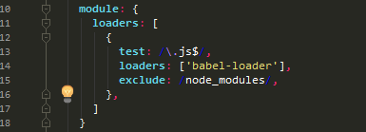
Transpiling with Babel
Now when we try to run `webpack` again, we get an error!
We need to introduce the following loaders in our webpack.config.js:
Here, we have a regex that checks all files that end in .js
Then it runs the ‘babel-loader’ on it

Slide 12
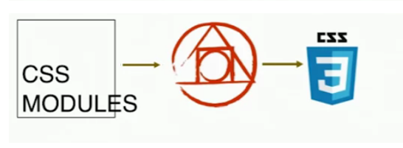
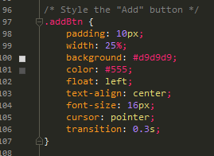
Loading CSS
Remember that CSS gets represented as Modules
CSS also has dependencies such as Fonts / Imgs
CSS Loader parses the CSS file and
resolves all the dependencies
CSS Modules will make a module out of it for Webpack
Style Loader is responsible for taking that Module and placing it between <style> </style> tags and injecting it into the DOM at runtime

Slide 13


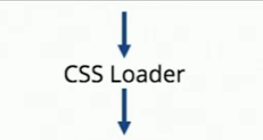
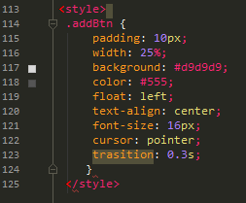

Loading CSS

